Slide 1


A Internship Seminar on “Move Home”
Visvesvaraya Technological University, Jnana Sangama, Belagavi
Kalpataru Institute Of Technology, Tiptur
Department of Computer Science and Engineering
Presented By, NAME: PRIYA J USN: 1KI20CS075 Under the Guidance of, Prof. Vidya H A B.E., M.Tech., (Ph.D.) Assistant Professor, Dept. of CSE, KIT

Slide 2
INTERNSHIP DOMAIN:
JAVA WEB APPLICATION DEVELOPMENT
Internship Duration | 8 Weeks ( 12th February 2024 to 8th April 2024)
Company Internship Guide | Mr. Nagamahesh B S, Senior Developer

Slide 3
Internship Tasks
About Company
Internship Task
Introduction on Project work
Software / Hardware Tools Details
Implementation Details
Skills Utilized
What I Learnt ?
Internship Outcomes
Project Demo / Screenshots
Conclusion
3

Slide 4

About company
InfiData Technologies An ISO 9001:2015 Certified IT Company, Accreditated by An International Accreditation Service (IAS). Head quartered in "silicon valley" of India Bengaluru, started in the year 2015. We are highly specialized in the design and development of websites, software application development, mobile app development, E-Commerce solutions and more.
Our team of expert professionals works on the latest software tools and technologies to give the best and promising services to our customers.
OUR SERVICES
Development | Training |Consulting
Address:
#1421, 1st Floor,16th B Cross, Sri Radha Building, Opp.To Dr. Agarwal Eye Hospital, Yelahanka New Town, Bengaluru-64
www.infidata.in | info@infidata.in
4

Slide 5
Internship Tasks
Task on:
Core Java Concepts
Java Database Connectivity
SQL Queries
HTML and CSS
Working with Web Templates
Java Server pages (JSP)
Servlet Programming
Project Work
5

Slide 6
Introduction to Project Work
Move Home:
This project focuses on creating a dynamic and user-friendly web application for Move Home, a packers and movers company, aimed at simplifying the booking and management of relocation services through digital innovation.
It aims to harness advanced technology to transform the market, establishing new benchmarks for service quality and reliability.
Through the online platform, Move Home plans to tap into a wider market, reaching potential customers across wider geographical areas.
The digital approach also opens up opportunities for scaling the business and exploring new customer segments. With a scalable architecture, the platform is designed to adapt to growing business needs and customer demands.

Slide 7
Software / Hardware Tools Details
Software:
JDK
Eclipse for Web and Enterprise Developer
XAMPP
Hardware :
Minimum PC Requirements

Slide 8
Implementation Details
Project Module Details
Home: The primary landing page introduces the website, showcasing key services like home moves, office relocations, and long-distance moving options. It includes a navigation bar, a main banner or image for visual appeal, quick access links to services, and introductory content to welcome users.
About: This page delves into the company's background, detailing its mission, core values, and journey. Information about the company history, the team, any certifications earned, and unique selling propositions are presented to build trust and connection with users.
Services:
Home Moves: Tailored solutions for residential relocations, ensuring a smooth transition for households.
Office Relocation: Specialized services designed to handle the complexities of moving business offices.
8

Slide 9
Reviews: A section dedicated to customer testimonials and feedback. It includes user-submitted reviews with ratings and provides an option for users to write a review after their service experience, fostering transparency and trust.
Register: A registration form that captures essential information like First name, Last name, Email, Password, Phone number, City, State, Pincode, and Full Address. This facilitates a secure sign-up process allowing users to create profiles to manage bookings and interactions.
User Login: A login form that requires Email and Password for user authentication. This enables returning users to access their profiles where they can manage their bookings, review submissions, and update personal information.
Movers Details: Displays a list of movers along with details such as ID, Name, Charges, and Phone number. Users have options to order services, view the status of existing orders, write reviews, and log out.

Slide 10

Admin Login: A specialized login portal for administrators. It provides access to an admin dashboard where website content, bookings, user accounts, and reviews can be managed effectively.
Order Details: A comprehensive table displaying details like order ID, Customer Name, Moving Date, Pickup Address, Delivery Address, Distance, Total Amount, and various action buttons. This provides administrators with the tools to view, edit, and manage orders seamlessly.
Enquiry: An enquiry form that includes fields for Email and Message, enabling potential customers to ask questions. This feature is geared towards enhancing customer service by facilitating direct communication.

Slide 11

Skills Utilized
Software Engineering Skills.
Web Application Building.
Administrative and collaboration tools using GitHub.

Slide 12
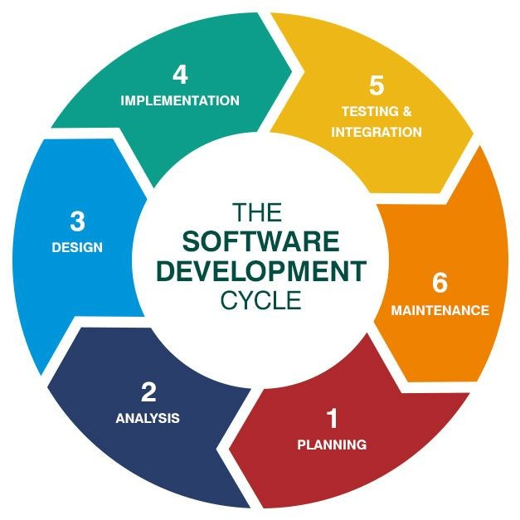
Skills Utilized
Technical skills
Soft skills
Industry-specific knowledge
Research skills
Creativity
Project Management
Adaptability
Multitasking
Presentation skills

Slide 13
What I learnt ?
Technical skills:
Soft skills:
Management skills:
Advance Java
Web Development
Database Connectivity
Servlets and JSP
Teamwork
Communication Skills
Design Working Culture
Project Management,
Time Management

Slide 14
Weekly Training/ Task Completion
Week | Date | Training Details | Task Details
1 | 12th Feb 24 to 24th Feb 24 | Core Java: Exception Handling, Constructors, Array of objects, OOPs Concepts. | Coding problems on topics like Little Quiz, Space Boxing, Fizz Buzz, Inheritance, Polymorphism.
2 | 26th Feb 24 to 2nd Mar 24 | Java Database Connectivity and SQL Queries. | Created and populated multiple tables; executed critical queries successfully.
3 | 4th Mar 24 to 9th Mar 24 | Trained in HTML, CSS, and web templates for comprehensive web development skills. | Crafted various web templates to enhance overall design flexibility.
4 | 11th Mar 24 to 23rd Mar 24 | Java Server Pages(JSP) and Servlet programming. | Develop interactive web pages using JSP and manage requests with Servlets.
5 | 25th Mar 24 to 8th Apr 24 | Test, Project, Presentation. | Project.

Slide 15

Internship Outcomes
Now I am able to design applications
Working with SDLC Approach
Utilizing the J2EE Framework
Growth : Critical Thinking and analysis
Lead the team and projects

Slide 16
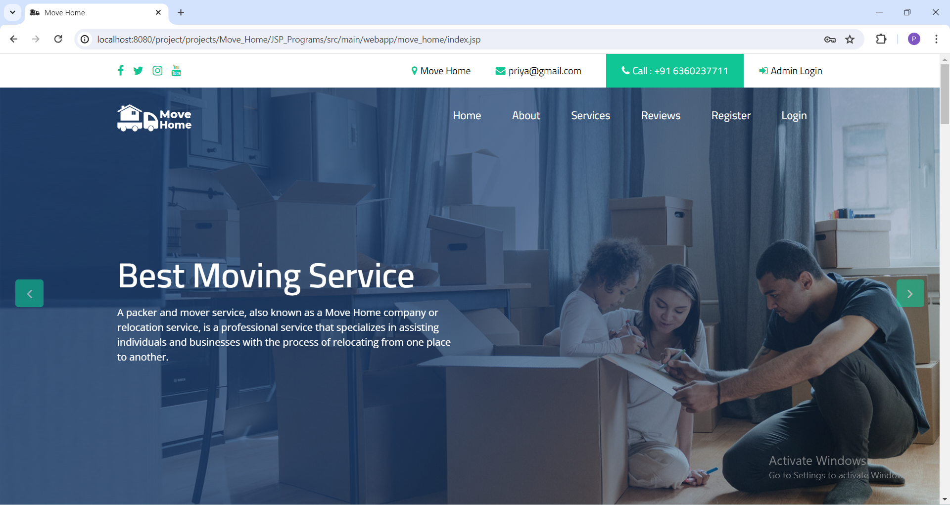
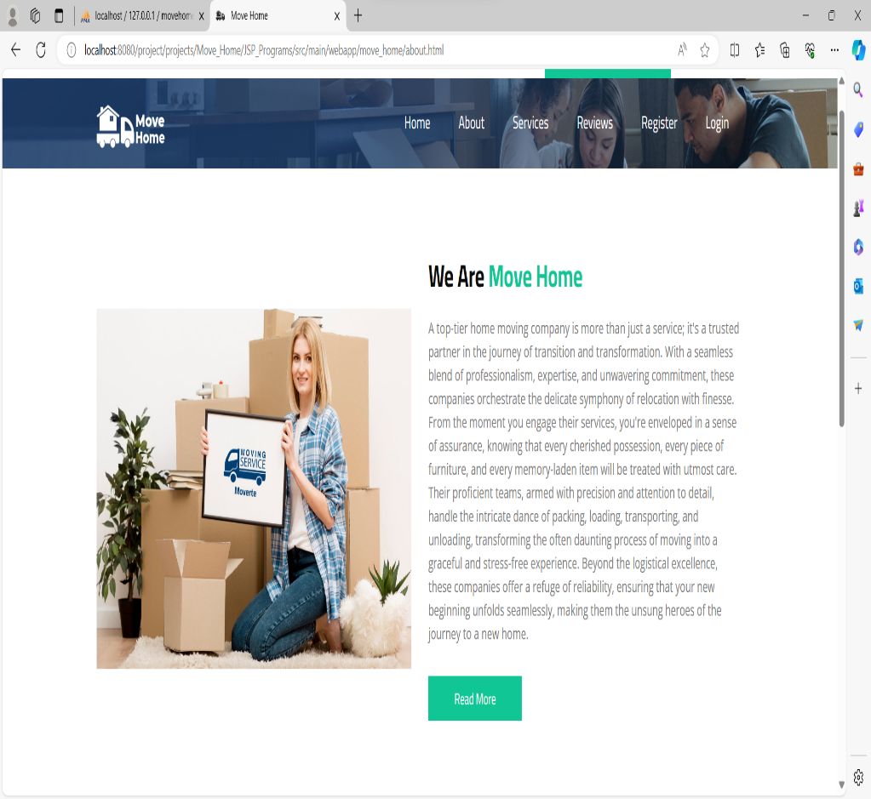
Screenshots
14

Slide 17
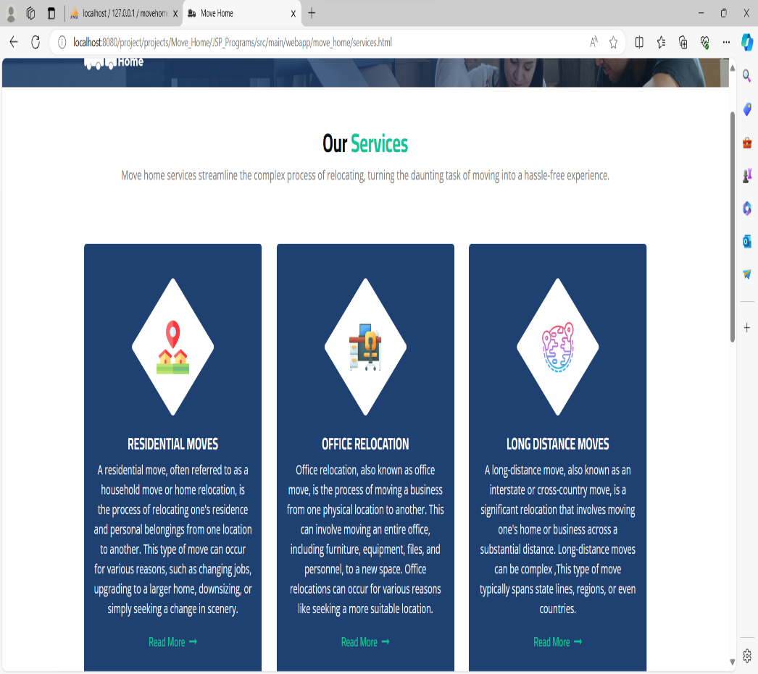
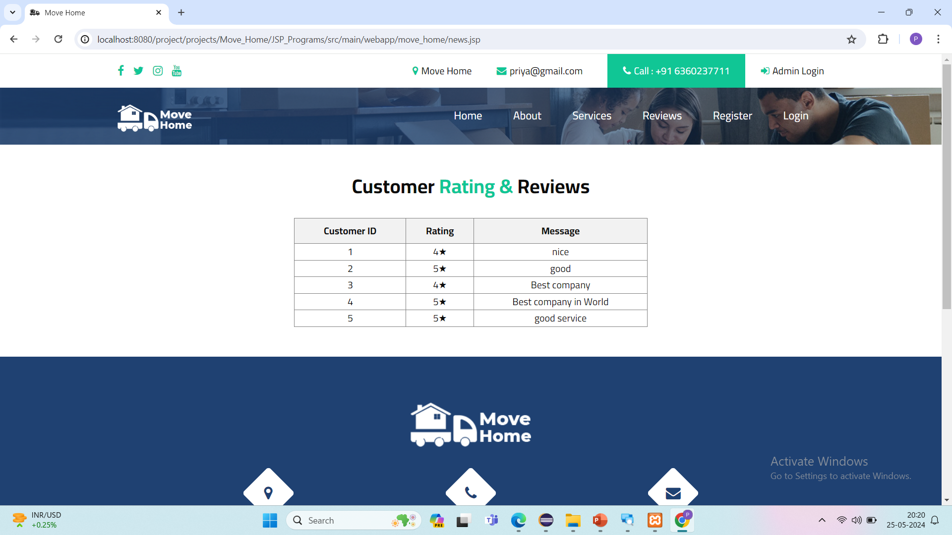
Services Customer Ratings

Slide 18
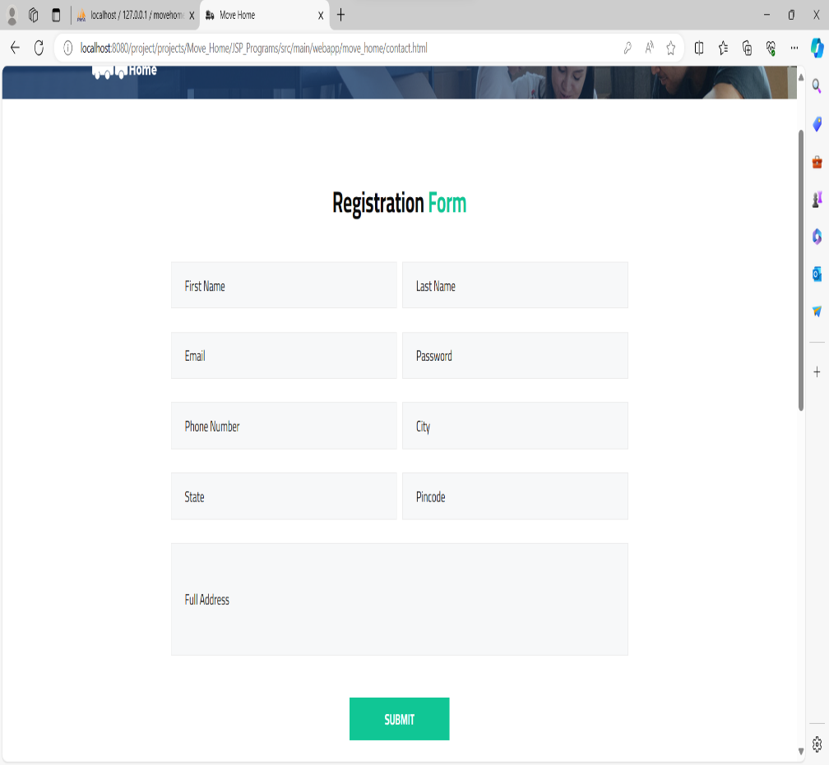
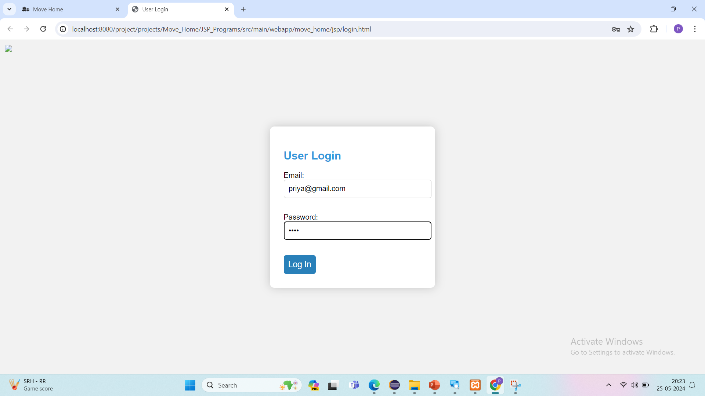
Registration Form User Login

Slide 19
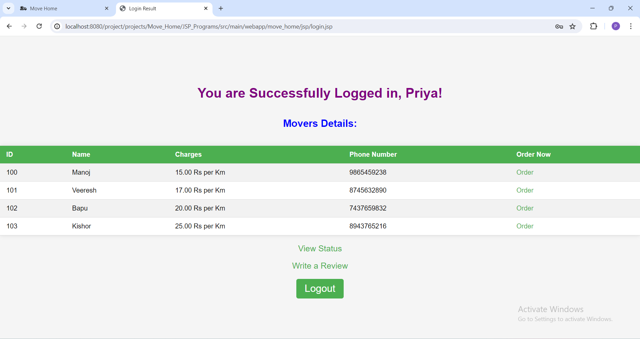
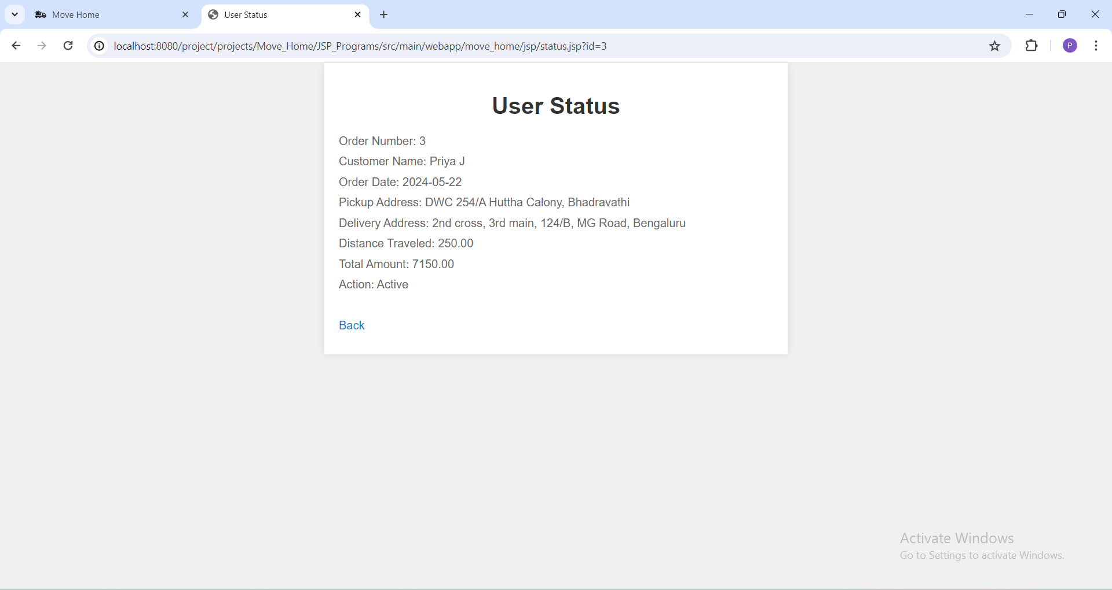
User Login Results

Slide 20
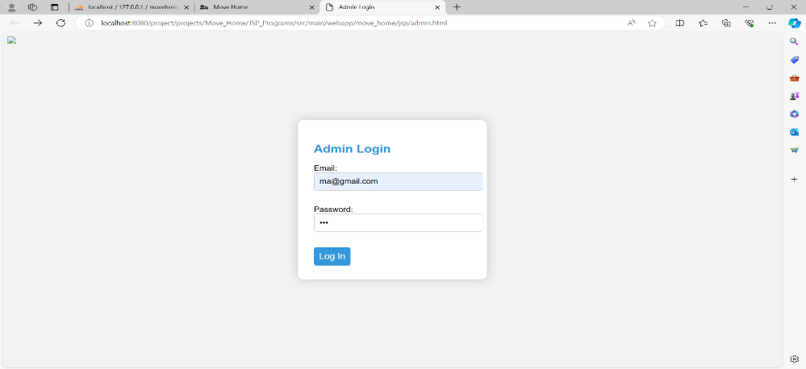
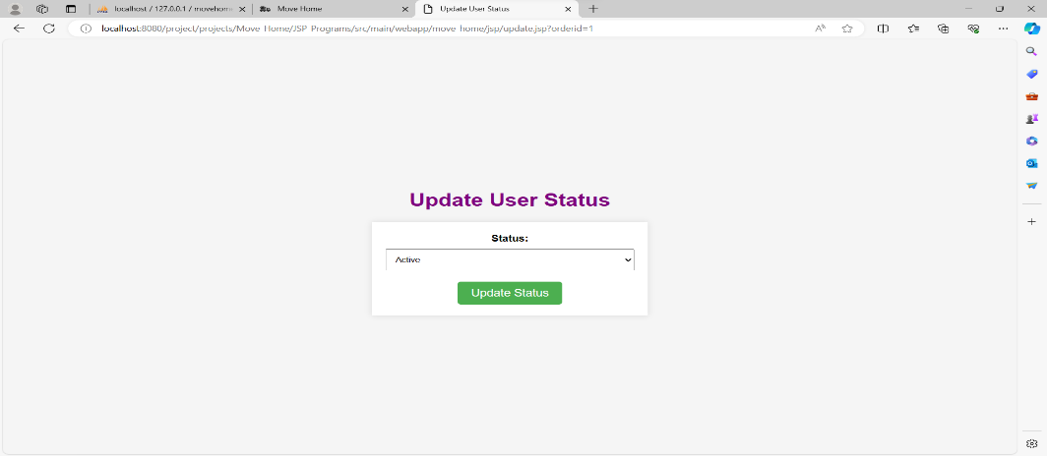
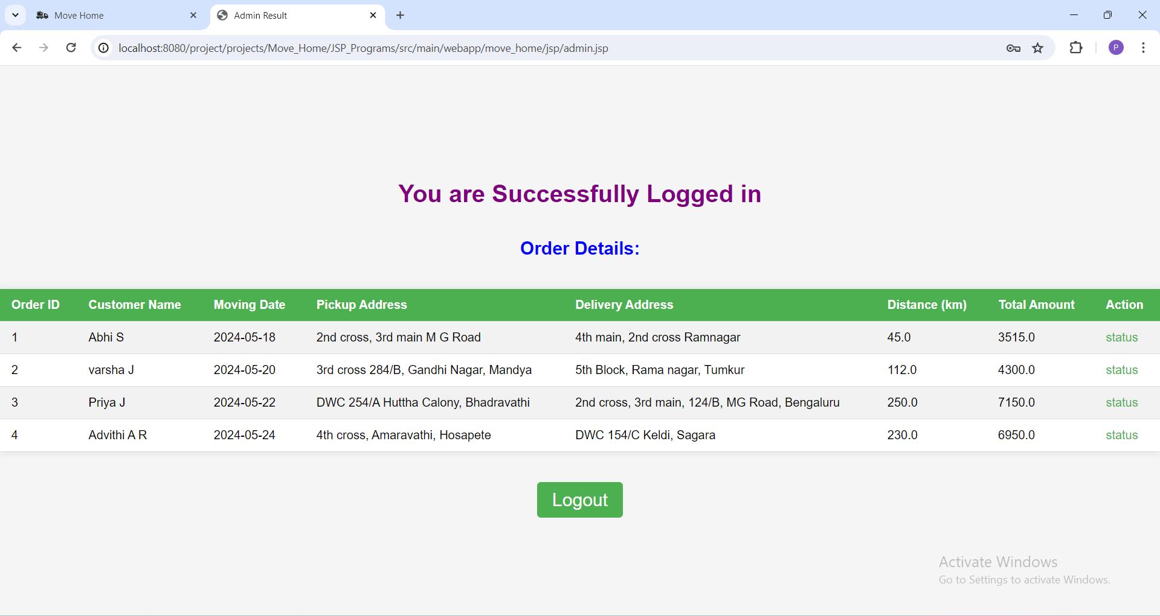
Admin Login Results

Slide 21
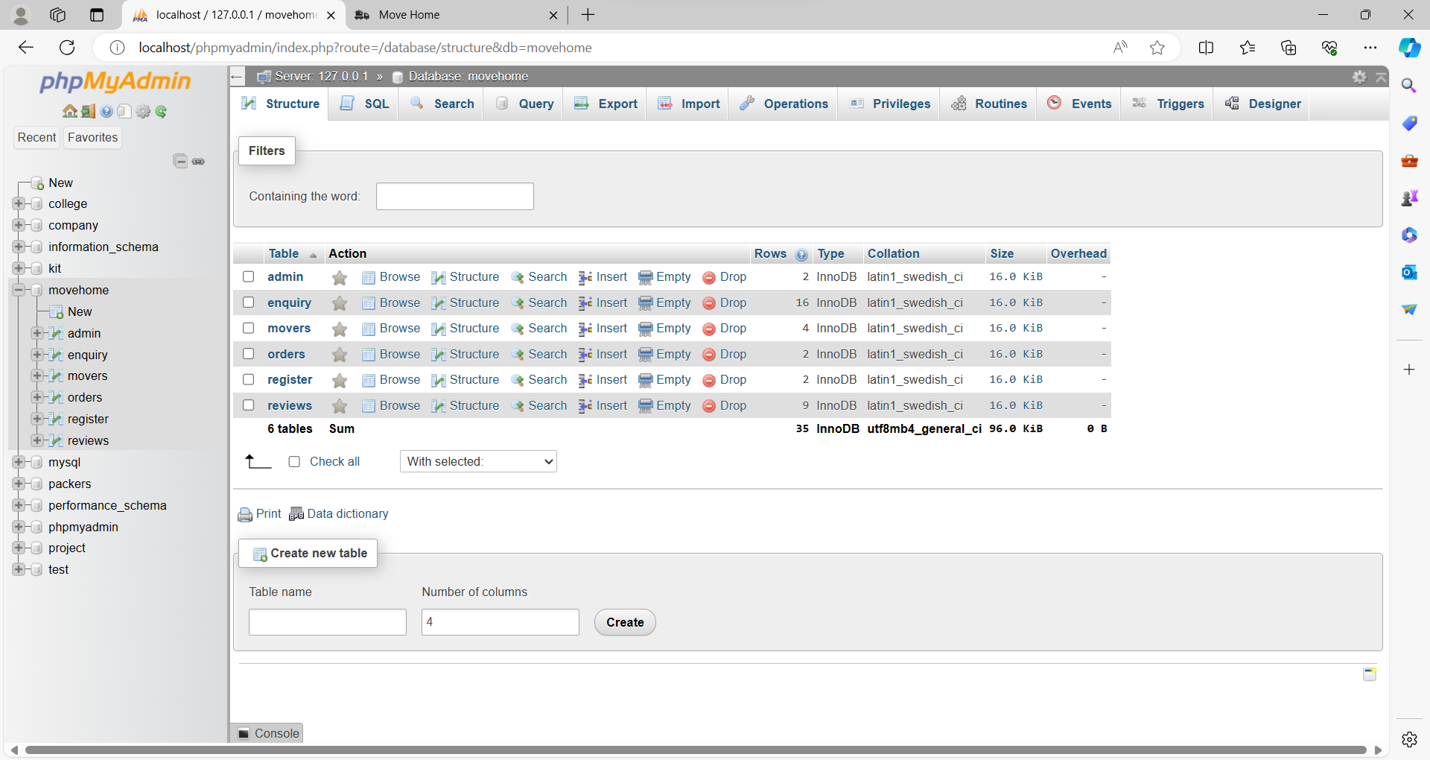
Move Home Database

Slide 22

Conclusion
This internship has been an excellent
and rewarding experience.
It was a great opportunity to improve personal and professional skills.
These valuable skills have boosted my professional skills to a higher level and prepare me for future career.

Slide 23

Thank You

